Slide 1
#GlobalKidsOnline
#LSEGlobalKidsOnline
@MediaLSE
@UNICEFInnocenti
@EUKidsOnline
www.globalkidsonline.net

Slide 2
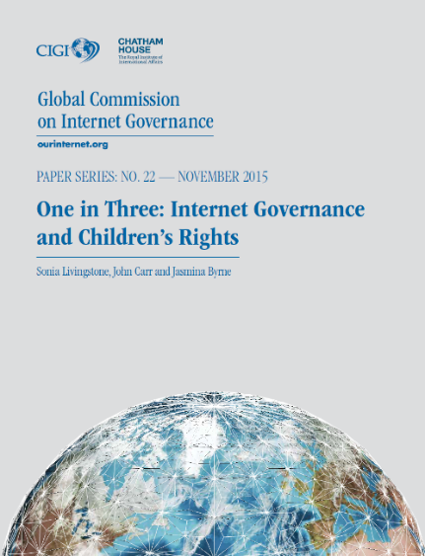
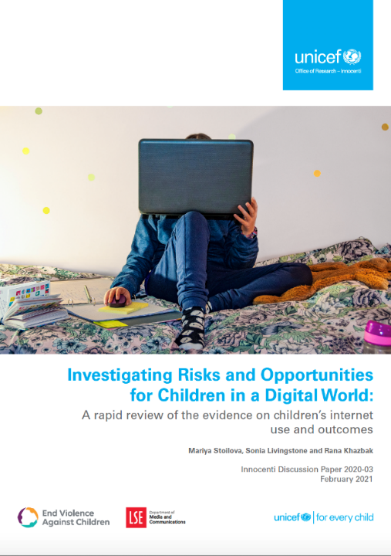
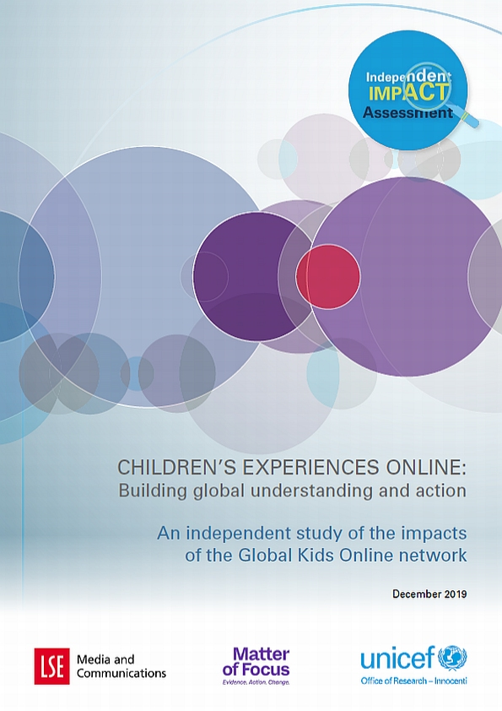
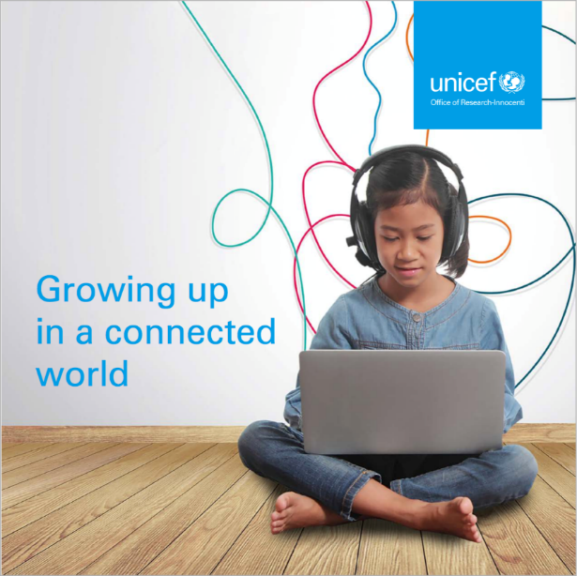

Slide 3
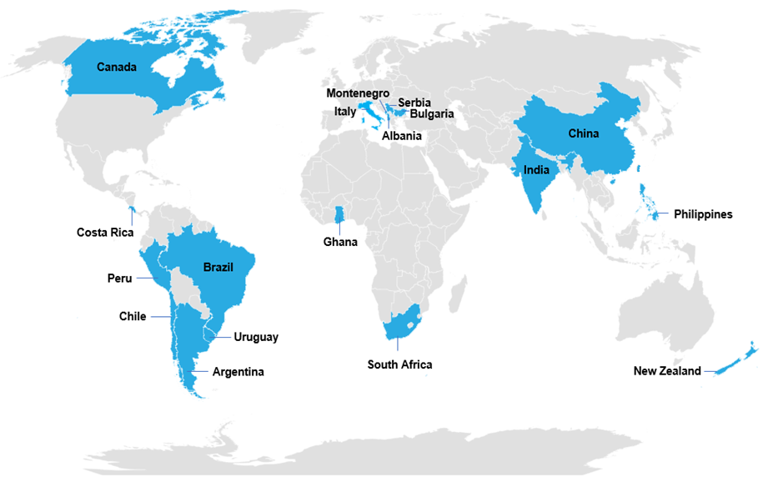
Building on GKO findings relating to 9-11 year olds, the UNICEF office developed a learning toolkit app and is now working with the Ministry of Education to support its use in IT classes.
The Ministry for Gender and Children and Social Protection uses GKO findings in the inclusion of COP in the revision of the Children's Act. A COP module was added to the community engagement toolkit used at regional, district and community levels
Ministry of Education and Science changed its policy discourse from technical skills to digital literacy, and integrated an hour of media education per year for all young people.
GKO findings were cited in contributing to the government’s National Broadband Plan and National Digital Strategy.
GKO research influenced the internet regulator to require service providers to reduce data costs, based on the finding that data costs are a barrier to children’s opportunities online.
The Department of Education is using the GKO findings to justify the curriculum integration of life skills, digital skills and digital wellness modules for younger children.
The GKO recommendation to promote digital literacy was included in the new Convergent Communications Law. Young adolescents, teachers, child protection and justice officers were provided training in Buenos Aires by creating a digital coexistence programme.
GKO research informed a public awareness campaign on internet security, guidance for parents was produced, and teachers co-produced interventions to share with other professionals.
globalkidsonline.net/impact-report/

